Slide 1
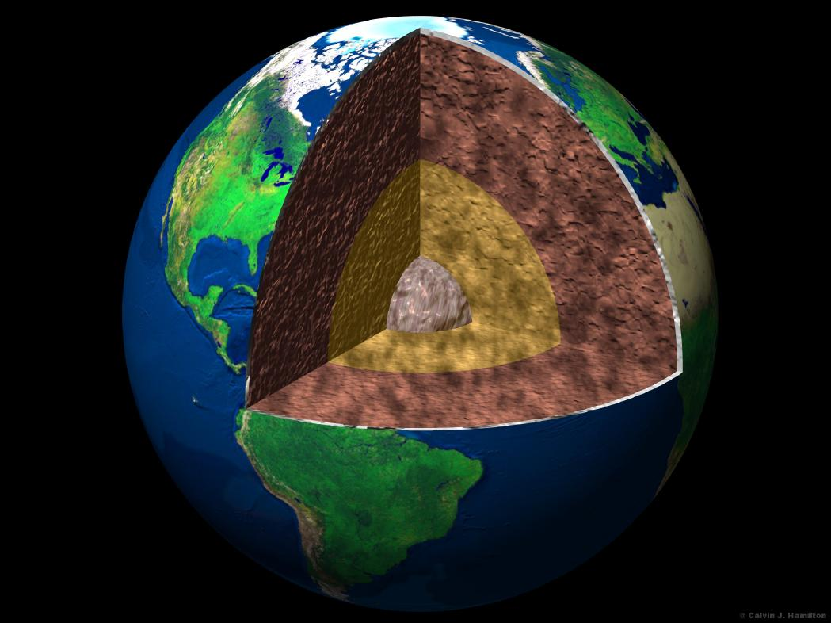
Earth's Interior Notes

Slide 2
Earth’s Layers Vocabulary
Inner core – a ball of hot solid metal at the center of the earth
Outer core – liquid layer of metal that surrounds the inner core
Mantle – earth’s thickest layer between the outer core and crust made of magma

Slide 3
Crust – the top layer of earth made of a thin layer of cool rock
Lithosphere – the layer of earth made of the crust and the rigid rock of the upper mantle which is broken into tectonic plates
Asthenosphere – the layer in earth’s upper mantle directly under the lithosphere in which rock is soft and weak because it is close to melting

Slide 4
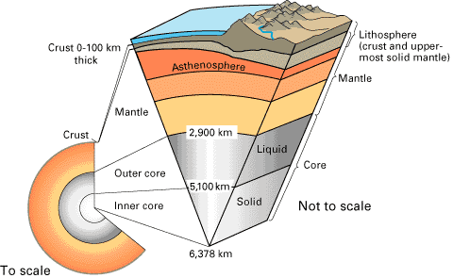
Cross-Section of the Layers of the Earth

Slide 5
Tectonic plates – the process in which the motion of a hot material under the crust changes the crust of the Earth. These are called plate tectonics
Continental drift – a hypothesis that Earth’s continents move on the surface
Fault lines – a crack in Earth’s surface

Slide 6
Pangaea – a hypothetical supercontinent in which all continents were once attached. It began breaking apart about 200 million years ago
Convection – a process by which energy is transferred to cause warmer less dense air or liquid to rise while the dense cooler liquid or air is pushed down.

Slide 7
Data Table
Depth | Name of Layer | What Layer is Made Of
20 km | crust | solid rock, mostly granite and basalt
150 km | asthenosphere (mantle) | soft slow flowing material
2,000 km | mantle | hot, but solid material
4,000 km | outer core | molten iron and nickel
6,000 km | inner core | solid iron and nickel

Slide 8
What are the layers of the Earth?

Slide 9
Earth’s Crust
Outer core
Mantle
Inner core

