Slide 1
Safety Vocabulary

Slide 2
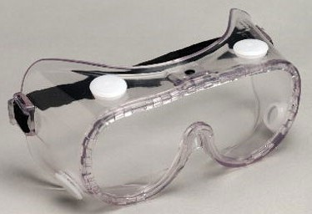
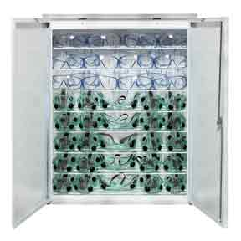
Goggles – worn to protect eyes
Goggle Sanitizer – used to sterilize (clean) goggles

Slide 3
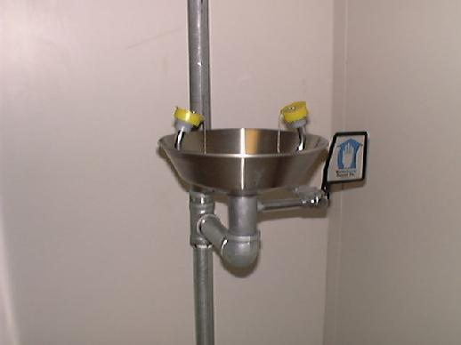
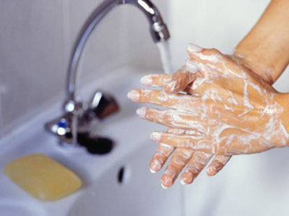
Eye Wash – where you rinse your eyes if chemicals splash on your face
Soap & Water – used to wash hands after each lab experiment

Slide 4
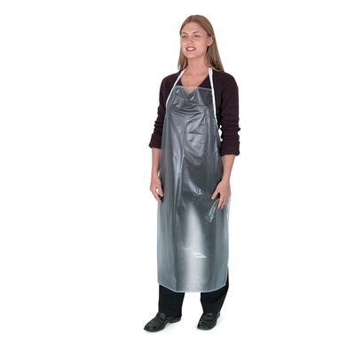
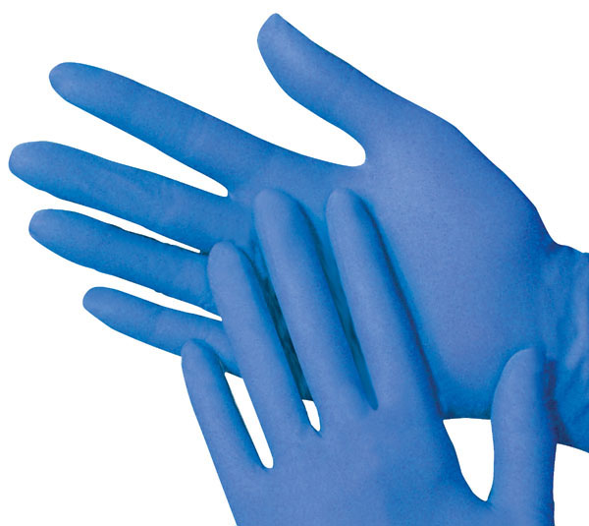
Gloves – material that cover and protects hands
Apron – cloth or plastic that covers
and protects the front of a person

Slide 5
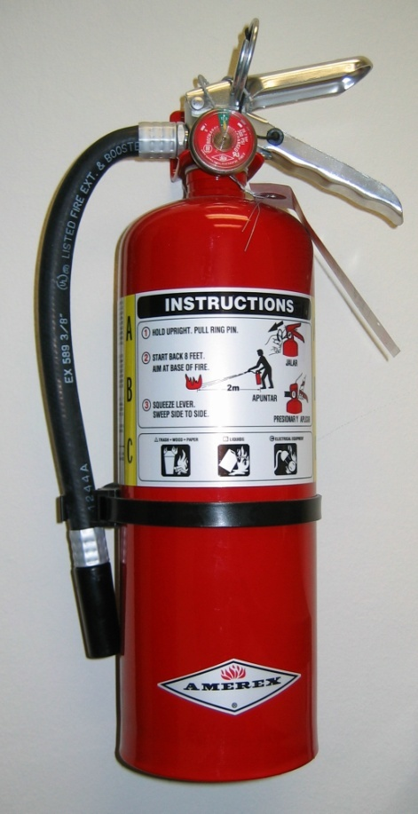
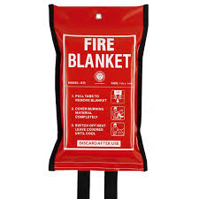
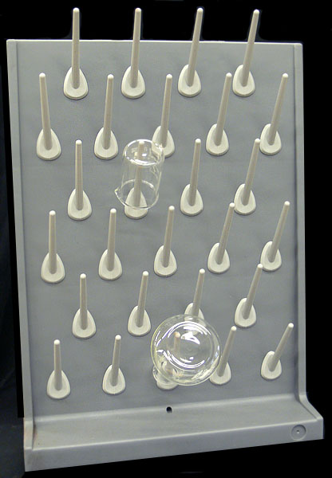
Fire Extinguisher/Fire Blanket– used by the teacher to put out small fires
Drying Racks – where materials are put to dry after they are cleaned

Slide 6
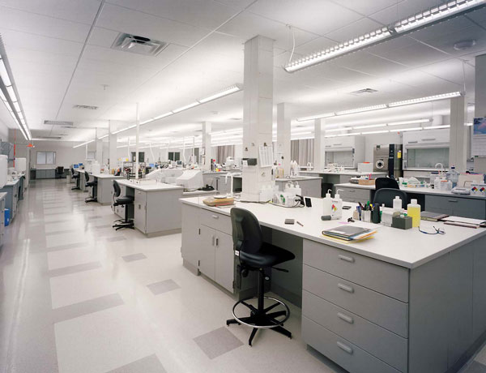
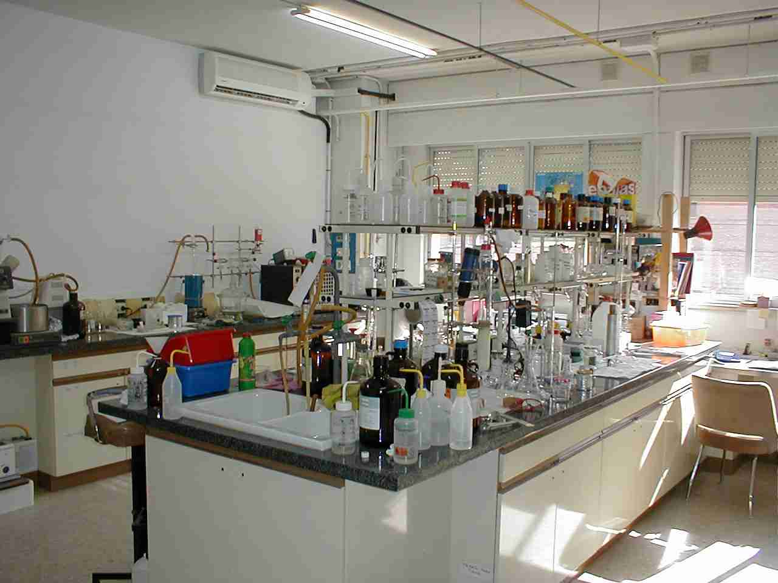
Laboratory (Lab) – place where science experiments are done

Slide 7
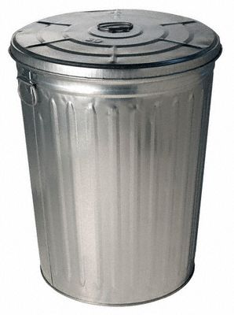
Waste Materials – chemicals or things left over after the experiment
Hazard – something dangerous

Slide 8
Laboratory Equipment

Slide 9
Measuring Volume
Beaker
Dropper
Graduated Cylinder

Slide 10
Measuring Distance
Meter Stick
Ruler

Slide 11
Measuring Mass
Digital Scale
Balance

Slide 12
Other Equipment
Hot Plate
Test Tube & Clamps

Slide 13
Now that we’ve learned what’s around us,
Let’s talk about proper behavior in the science classroom.

Slide 14
Proper Dress
Long hair must be pulled back
Goggles must stay OVER your eyes for the entire duration of the lab
No long sleeves
No jewelry on the wrists on fingers
Must wear pants that come to the ankles (no shorts/capris)
Must wear closed-toe shoes that cover the entire foot (no sandals, Toms, “boat shoes,” etc.)
If aprons are used, keep them on for the duration of the lab
**If you are not dressed appropriately according to the guidelines above, you will have to complete an alternate assignment.

Slide 15
Behavior
Upon entering the room, there may be lab supplies on the desk. DO NOT touch these materials until the teacher or another adult in the room directs you to do so.
During the lab, listen carefully to all directions by the teacher.
Do not skip any steps or move ahead without permission from the teacher.
If there is an accident where something is spilled or a piece of equipment is broken, notify the teacher IMMEDIATELY and NEVER try to pick up broken glass.
Do not play around during a lab. We can have fun, but horseplay could cause someone to get hurt. Do not run or put your hands on someone ever, but especially during a lab. Safety is our goal!
Even if the class period has ended, do not leave your lab station until you have cleaned up and reset the materials for the next class.
**Failure to comply with these rules will result in your lab privileges being revoked; you will instead get an alternate assignment to complete.

