Slide 1
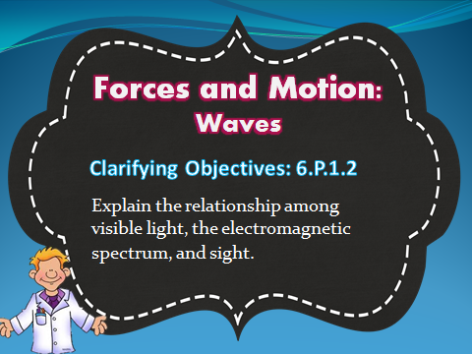

Slide 2
Light Waves
Notes:
Extension

Slide 3
What is light?
Notes:
6.P.3.2

Slide 4
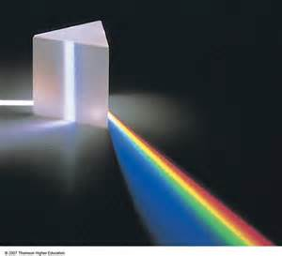
Light
Light
Properties and Interactions

Slide 5
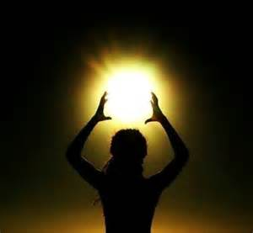
What is Light?
Light is a form of energy emitted by the Sun.

Slide 6
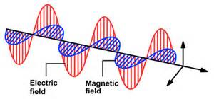
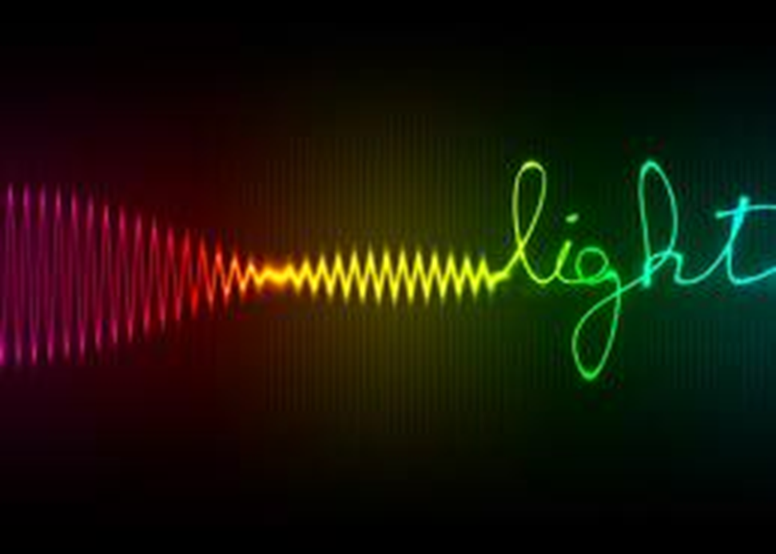
What is Light?
Light is a type of energy that travels as an electromagnetic wave.
Consists of changing electric & magnetic fields
Can travel through empty space or matter

Slide 7

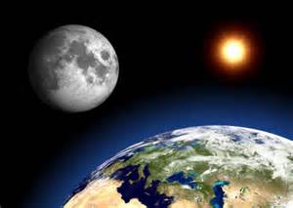
When Can You See Light?
The object must be a source of light itself
  -Example: The Sun
    (all stars)
Light must bounce off the object
  -Example: The Moon

Slide 8
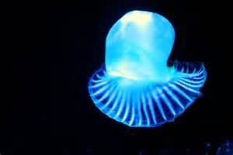
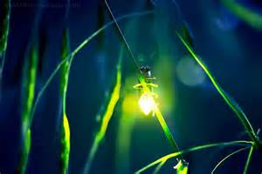
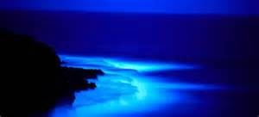
When Can You See Light?
bioluminescence – light produced by living organisms
  fireflies
  bioluminescent bacteria

Slide 9
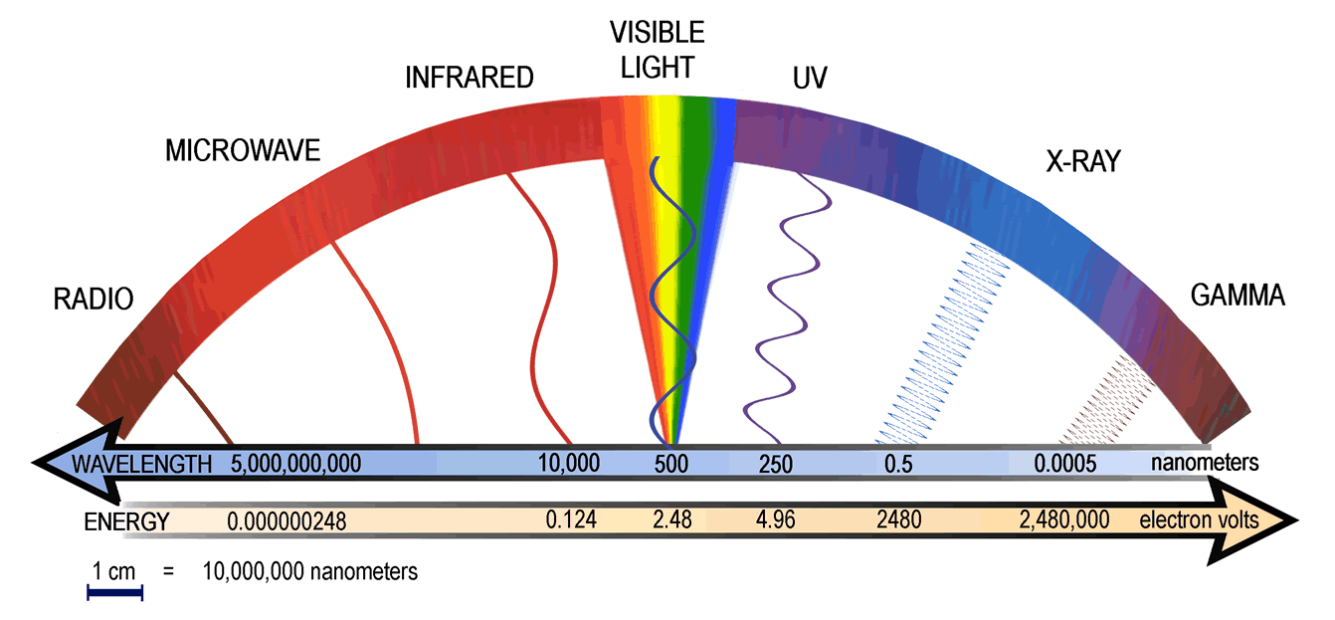
Light is carried by electromagnetic waves.
ELECTROMAGNETIC WAVES

Slide 10
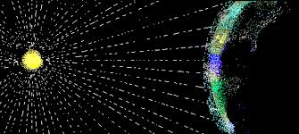
ELECTROMAGNETIC WAVES
Just how fast is light?
Electromagnetic waves are waves that do not require a medium to travel.
(a substance to travel through)
empty space
Notes:
When light interacts with matter it is either:
absorbed
transmitted
refracted
reflected (scattered). An example of scattering is when the sky is blue.

Slide 11
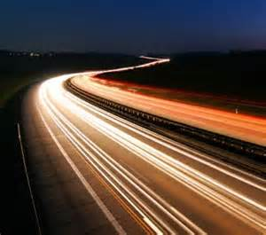
The speed of light is the fastest thing known to scientists.

Slide 12
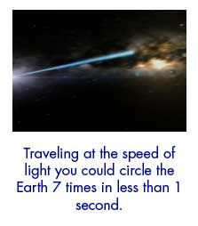
Light travels at 300,000 km/second or over 186,000 miles/second!

Slide 13
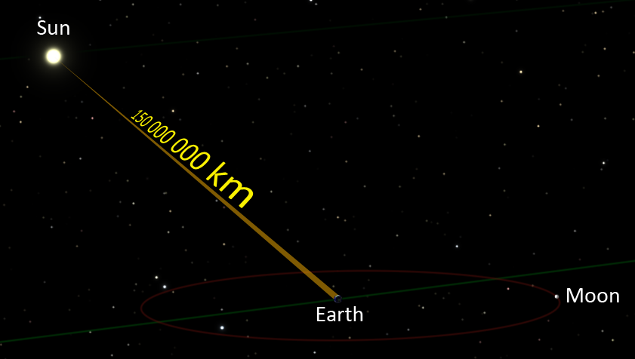
LIGHT FROM THE SUN
Earth is about 150 million km or 93 million miles away from the sun.

Slide 14
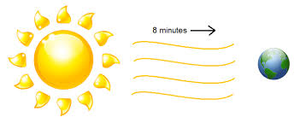
It takes 8.3 minutes for light to travel from the sun to Earth.

Slide 15
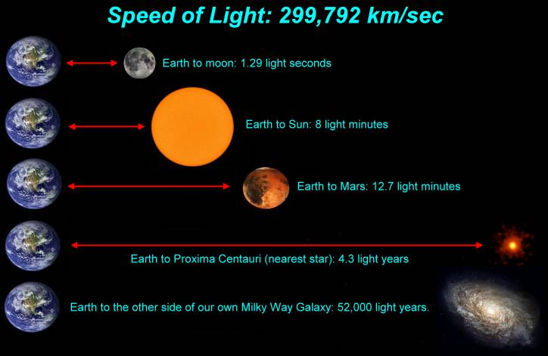

Slide 16
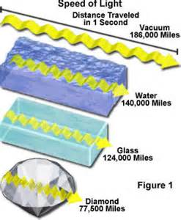
Light travels faster in the vacuum of space than it does in matter (such as air and gas)

Slide 17
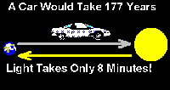
How Does Light Travel?
Light travels fast and straight!
light ray – a straight-line beam of light as it travels outward from its source
  Example - Flashlight

Slide 18

Transverse Waves:
Light travels as a transverse wave, in an up and down motion.
http://www.youtube.com/watch?v=UHcse1jJAto&feature=player_detailpage#t=8
Notes:
not sure?

Slide 19
How does light interact with matter?
Notes:
6.P.3.3

Slide 20
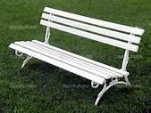

On a bright, sunny day – which bench would you rather sit on? Black or White?
Why??????

Slide 21
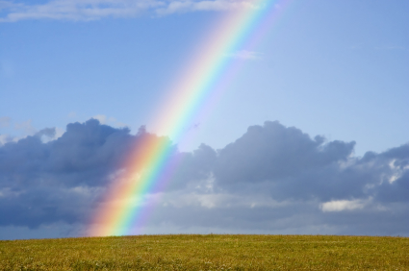
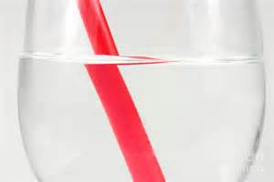
All waves can be deflected, distorted or changed when they come in contact with a boundary.
WAVE DISTURBANCES

Slide 22
When light interacts with matter it is either:
WAVE DISTURBANCES
absorbed
Notes:
I can explain when light interacts with matter it is: absorbed, transmitted, refracted or reflected (scattered)

Slide 23
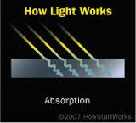
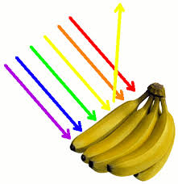
Absorption: Occurs when light waves transfer energy to particles of matter.
Light stops at the object and does not reflect or refract.

Slide 24
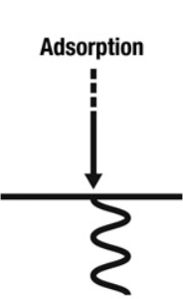
When incoming light hits an object it causes its atoms to vibrate. It then converts the energy into heat which is radiated.
ABSORPTION

Slide 25

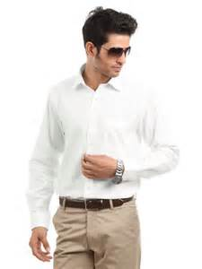
Absorption and Color
Why do you feel warmer when you wear a black shirt vs. wearing a white shirt?
Notes:
discuss

Slide 26
Absorption and Color
A black shirt absorbs all wavelengths of light, absorbing the energy and turning it to heat
A white shirt reflects all wavelengths of light.

Slide 27

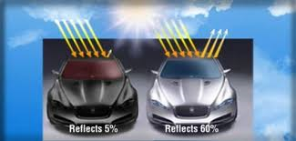
Anyone with a dark-colored car on a hot day will experience the effects of absorption.
ABSORPTION

Slide 28
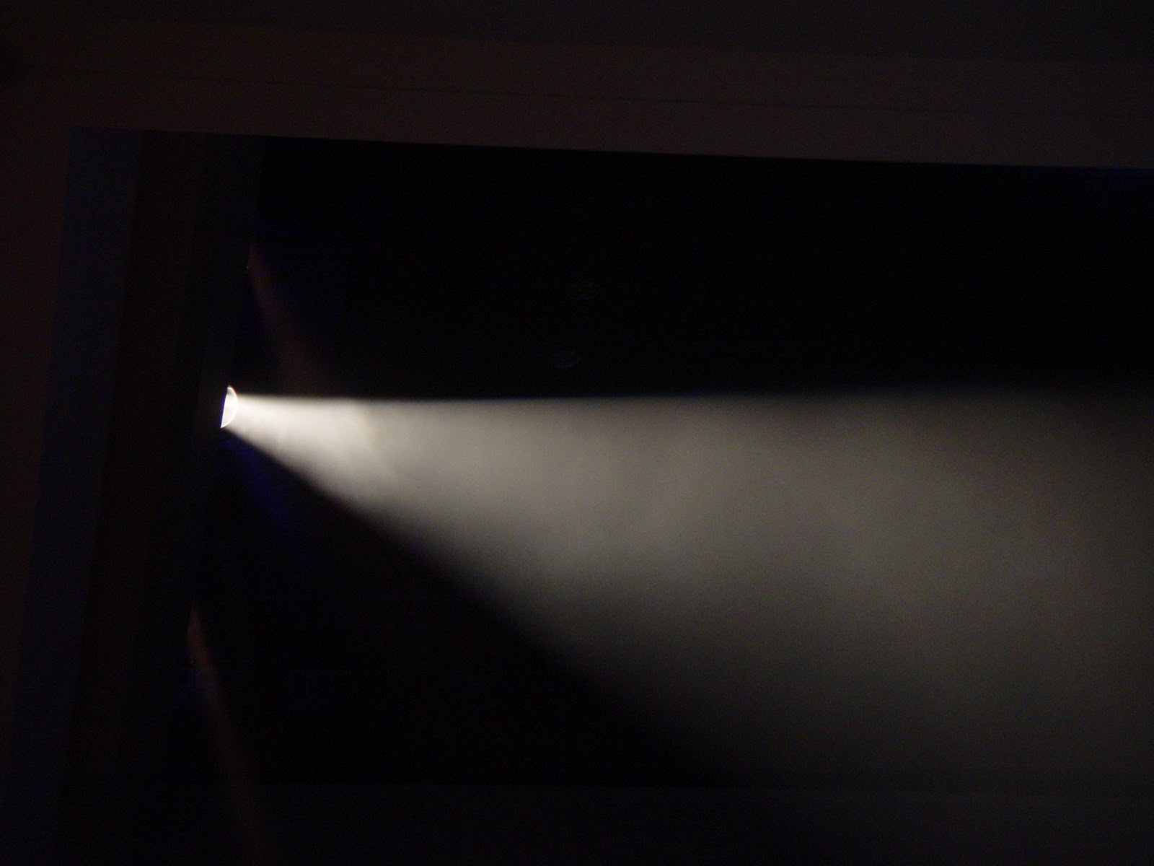
ABSORPTION
The beam of light from this flashlight is being absorbed as it passes through matter. It becomes less intense the further it travels from the light source.

Slide 29

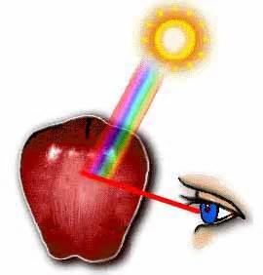
ABSORPTION
When light hits a non-reflecting surface, the light waves are absorbed by the object. However, the light waves that are the same color as the object are not absorbed. Instead, those light waves bounce off the surface, are transmitted to the human eye, and are interpreted as the color of the object.
yellow bananas, reflect only the yellow part of sunlight but absorb the light of all other colors.

Slide 30
When light interacts with matter it is either:
absorbed
transmitted

Slide 31
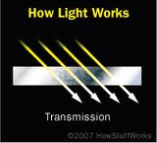
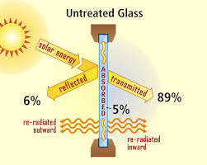
Transmission: Occurs when light waves pass through an object without interacting.

Slide 32
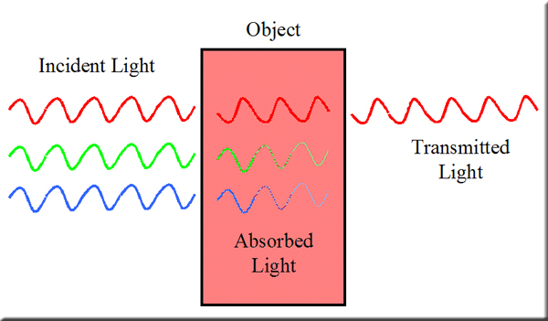
TRANSMISSION

Slide 33
When light interacts with matter it is either:
absorbed
transmitted
refracted

Slide 34
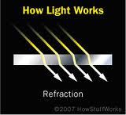
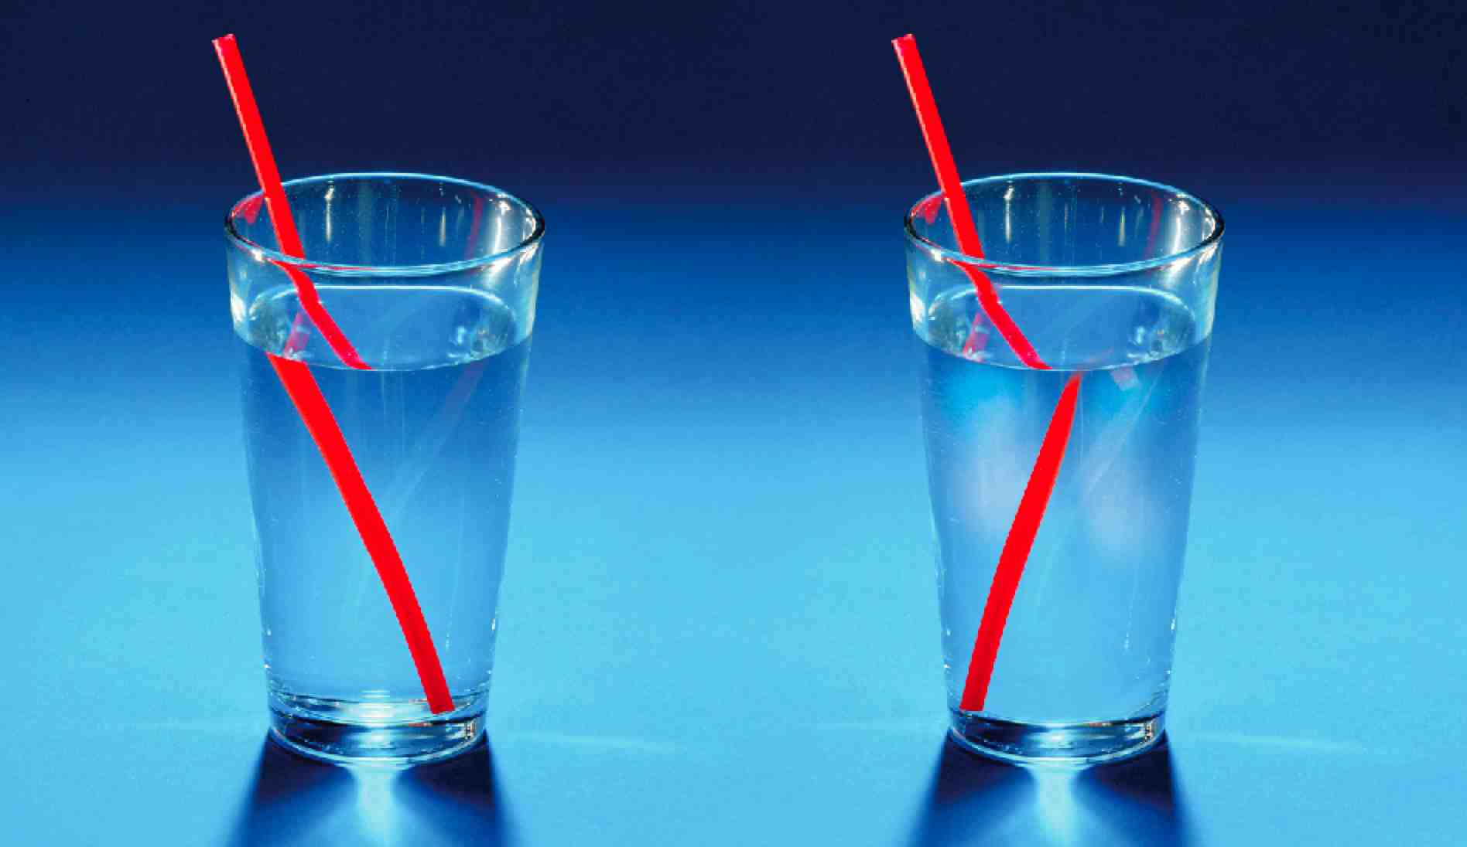
Refraction: is the change in direction of a wave when it changes speed as it travels from one material(medium) to another.
Notes:
The bending of a wave as the wave passes between two substances in which the speed of the wave differs

Slide 35
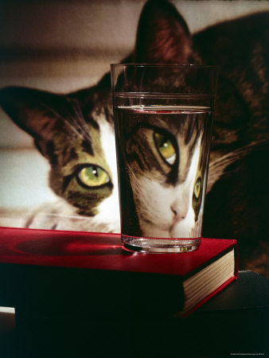
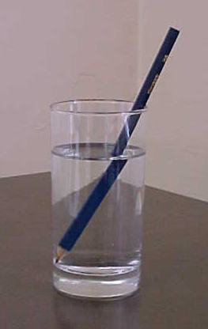
REFRACTION

Slide 36
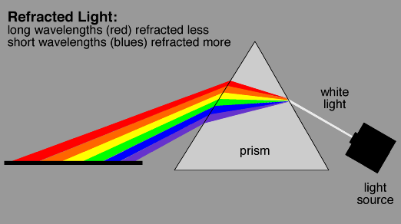
REFRACTION

Slide 37
REFRACTION

Slide 38
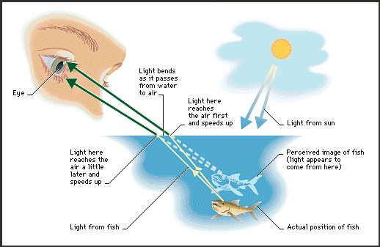
REFRACTION

Slide 39
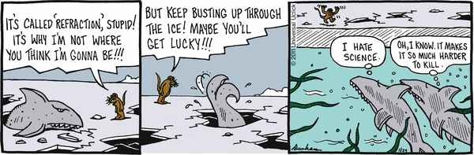
REFRACTION

Slide 40
When light interacts with matter it is either:
absorbed
transmitted
refracted
reflected

Slide 41
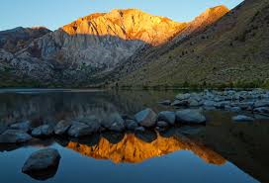
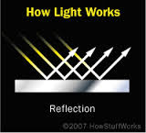
Reflection: Occurs when light waves bounce off of an object.

Slide 42
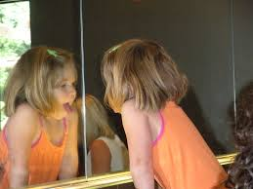
REFLECTION

Slide 43

REFLECTION
Bananas are yellow because the color yellow is being reflected off of the bananas. All of the other colors of light are being absorbed into the bananas.

Slide 44
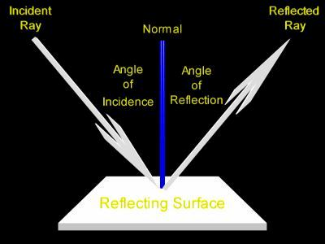
REFLECTION

Slide 45
When light interacts with matter it is either:
absorbed
transmitted
refracted
reflected
scattered (form of reflection)

Slide 46
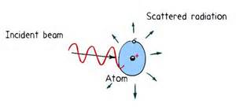
Scattering: an interaction of light with matter that causes light to change direction. Light scatters in all directions.
An example of scattering is when the sky is blue

Slide 47

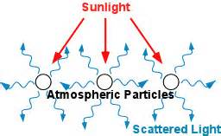
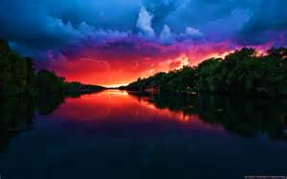
This explains why the sky is blue?
Sunlight reaches Earth's atmosphere and is scattered in all directions by all the gases and particles in the air. Blue light is scattered in all directions by the tiny molecules of air in Earth's atmosphere.
Because blue has a short wave length, it is particularly susceptible to scattering as it bounces off gas particles of the air surrounding Earth. Red, yellow and orange hues are much longer wavelengths, which is why they are only visible in the sky when looking near or at the sun.

Slide 48
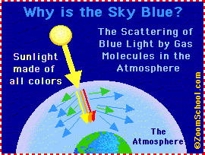

Slide 49
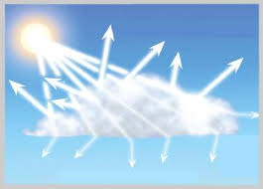
SCATTERING

Slide 50
Reflection vs. Scattering
If you shine a narrow beam at a highly polished surface (like a mirror), you get a narrow beam of light reflected back off it
If you shine a narrow beam of light at a rough surface, the light scatters in all directions

Slide 51
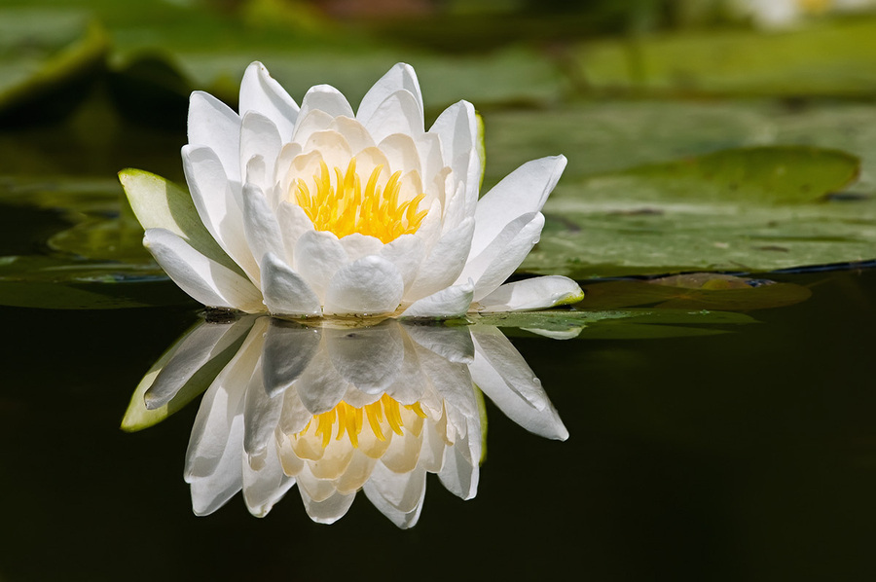

Reflection vs Scattering
When light reflects off a surface, it obeys the law of reflection (the angle of incidence is equal to the angle of reflection), whether or not the surface is smooth. The light is reflecting off the flower to the water and then back to your eye. In the wavy water, the light is scattered so you do not see a perfect reflection.

Slide 52
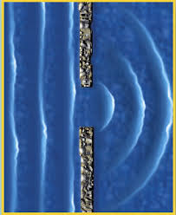
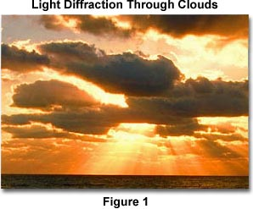
Diffraction: Occurs when waves bend around a barrier.

Slide 53


DIFFRACTION
Diffraction explains why you see a ring around the moon when it is bright. It also explains how holograms work.

Slide 54

DIFFRACTION

Slide 55

DIFFRACTION

Slide 56

Can you identify each type of light interaction occurring?

Slide 57


Slide 58

When light interacts with matter it is either:
absorbed
transmitted
refracted
reflected
scattered

Slide 59

WORD | Definition | Example | Picture
REFLECTED
REFRACTED |  | is the change in direction of a wave when it changes speed as it travels from one material(medium) to another.
SCATTERING
ABSORPTION | The process by which materials take in light and change it into heat.
TRANSMITTED
Notes:
Fill in graphic organizer…..attachment of this is included in word format

Slide 60


Slide 61


Slide 62
Journal Work
Head your paper like this:
Reflection vs. Scattering
In the video I noticed……
During reflection, light waves…..
When light scatters…
I observed……
We will watch a short 5 minute video clip on the difference between reflection and scattering. Following the video clip, you will reflect on these differences using complete sentences in your journal. We will spend 7 minutes writing our reflections
examples of how sentence may begin…
http://www.teachersdomain.org/asset/lsps07_vid_lightreflect/
Notes:
http://www.teachersdomain.org/asset/lsps07_vid_lightreflect/

Slide 63
How does the sun send its energy to earth?
Notes:
6.P.3.3

Slide 64

Journal Work
LIGHT
How many words can you make from the root
word light?
Notes:
Day One activator

Slide 65

Light waves aren’t the only kind of electromagnetic waves. In fact, there is an entire spectrum of electromagnetic waves, as shown.
The electromagnetic spectrum is the complete range of electromagnetic wave frequencies and wavelengths.
At one end of the spectrum the waves have low frequency, long wavelength, and low energy.
At the other end of the spectrum the waves have high frequency, short wavelength, and high energy.
All of the waves—from radio waves to visible light to gamma rays— are the same kind of waves. They differ from each other only by their frequencies, wavelengths, and energy.

Slide 66
Electromagnetic Spectrum

Slide 67

The sun’s energy arrives as light with a range of wavelengths. These wavelengths consist of:
  Visible Light
  Infrared Light
  Ultraviolet Light
all 3 are electromagnetic waves

Slide 68

Visible Light
Visible Light: the portion of the electromagnetic spectrum that is visible to human eyes.

Slide 69

Visible Light
Electromagnetic radiation in this range of wavelengths is called visible light or simply light.

Slide 70

Visible Light
Violet light is bent the most because it has the shortest wavelength. Red light is bent the least.

Slide 71

Each color travels with a different wave length.
The color red has the longest wave length.
Violet has the shortest wave length.

Slide 72

Visible Light
The range of electromagnetic waves between 700 and 400 billionths of a meter is special, because that is the range of wavelengths people can see.
Electromagnetic waves in this range are called visible light. This diagram shows how different wavelengths correspond to different colors of light.

Slide 73


Sunlight is not light of just one color—it's what we call white light, made up of all the different colors mixed together. Rainbows appear when light from the sun is refracted (bent) by droplets of water.

Slide 74

When white light is refracted through a prism, you can also see the spectrum of colors.

Slide 75


Visible Light and Color
Visible light can be seen by humans. Visible light is actually made up of many colors. A prism separates visible light into its colors.

Slide 76


Electromagnetic Waves from the Sun
43%
49%
Most of the energy emitted by the Sun is in the form of ultraviolet, visible, and infrared waves. These waves carry energy away from the Sun and spread out in all directions. Only a tiny fraction of this energy reaches Earth. Most of the ultraviolet waves from the Sun are blocked by Earth’s atmosphere. As a result, almost all energy from the Sun that reaches Earth’s surface is carried by infrared and visible electromagnetic waves.
About 49 percent of
the electromagnetic waves emitted by the Sun are infrared waves, about 43 percent are visible light,
and about 7 percent are
ultraviolet waves.

Slide 77
When light hits an object what happens?
Notes:
6.P.3.3

Slide 78

When light strikes any form of matter, it can interact with the matter in 3 ways.

Slide 79



When light hits an object what happens?
Some objects do not allow light to pass through.
Opaque: no light can pass through

Slide 80




When light hits an object what happens?
Opaque objects do not allow light to pass through, this makes a dark shadow.
Opaque: no light can pass through

Slide 81




When light hits an object what happens?
Some objects allow some light to pass through.
Translucent: some light can pass through

Slide 82



When light hits an object what happens?
Translucent objects allow some light to pass through. This makes a light shadow.
Translucent: some light can pass through

Slide 83



When light hits an object what happens?
Some objects allow some light to pass through.
Transparent: light can pass through easily

Slide 84

When light hits an object what happens?
Transparent objects let almost all light pass through. So there is a very slight shadow or no shadow at all.
Transparent: light can pass through easily

Slide 85
How can you remember?

Slide 86
How can you remember?
Opaque

Slide 87
How can you remember?
Opaque

Slide 88
How can you remember?
Opaque
Translucent

Slide 89
How can you remember?
Opaque
Translucent
some
light

Slide 90
How can you remember?
Opaque
Translucent
some
light
Transparent

Slide 91

How can you remember?
Opaque
Translucent
Transparent
some
light
they see everything!

Slide 92

Look around the
classroom to find
more objects that are
opaque, translucent, or transparent.
Copy this chart into your notes
Opaque | Translucent | Transparent

