Slide 1
Safety Vocabulary

Slide 2
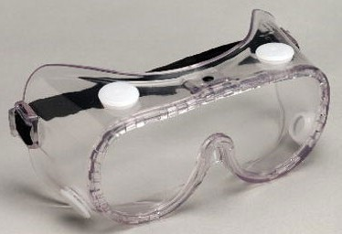
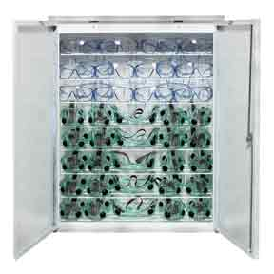
Goggles – worn to protect eyes
Goggle Sanitizer – used to sterilize (clean) goggles

Slide 3
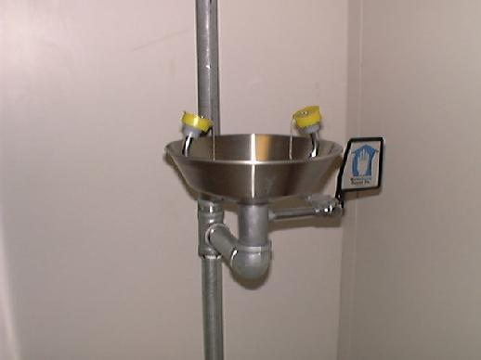
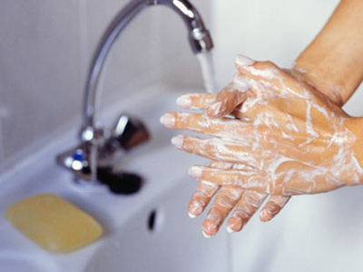
Eye Wash – where you rinse your eyes if chemicals splash on your face
Soap & Water – used to wash hands after each lab experiment

Slide 4
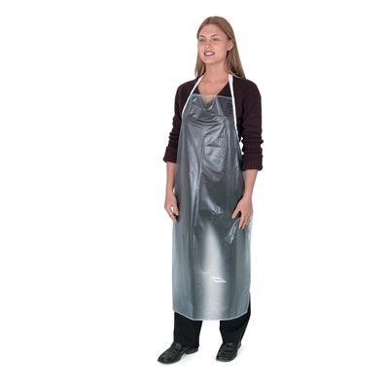
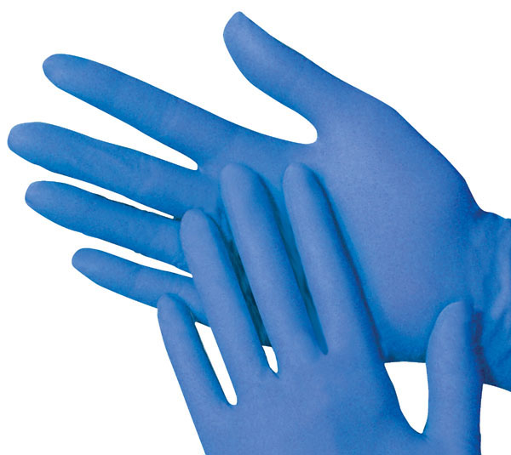
Gloves – material that cover and protects hands
Apron – cloth or plastic that covers
and protects the front of a person

Slide 5
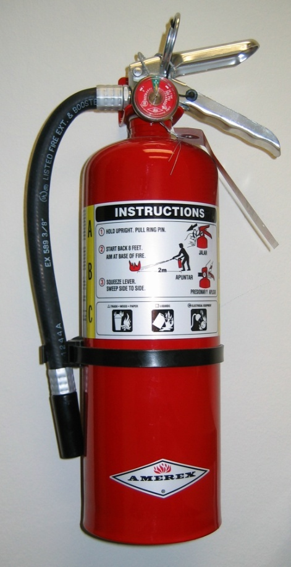
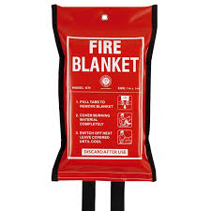
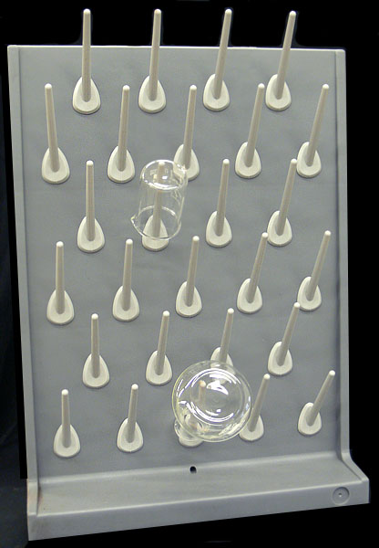
Fire Extinguisher/Fire Blanket– used by the teacher to put out small fires
Drying Racks – where materials are put to dry after they are cleaned

Slide 6
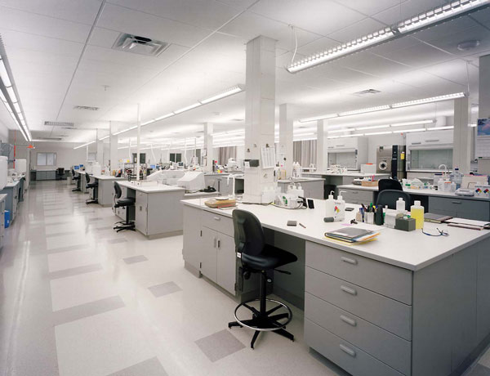
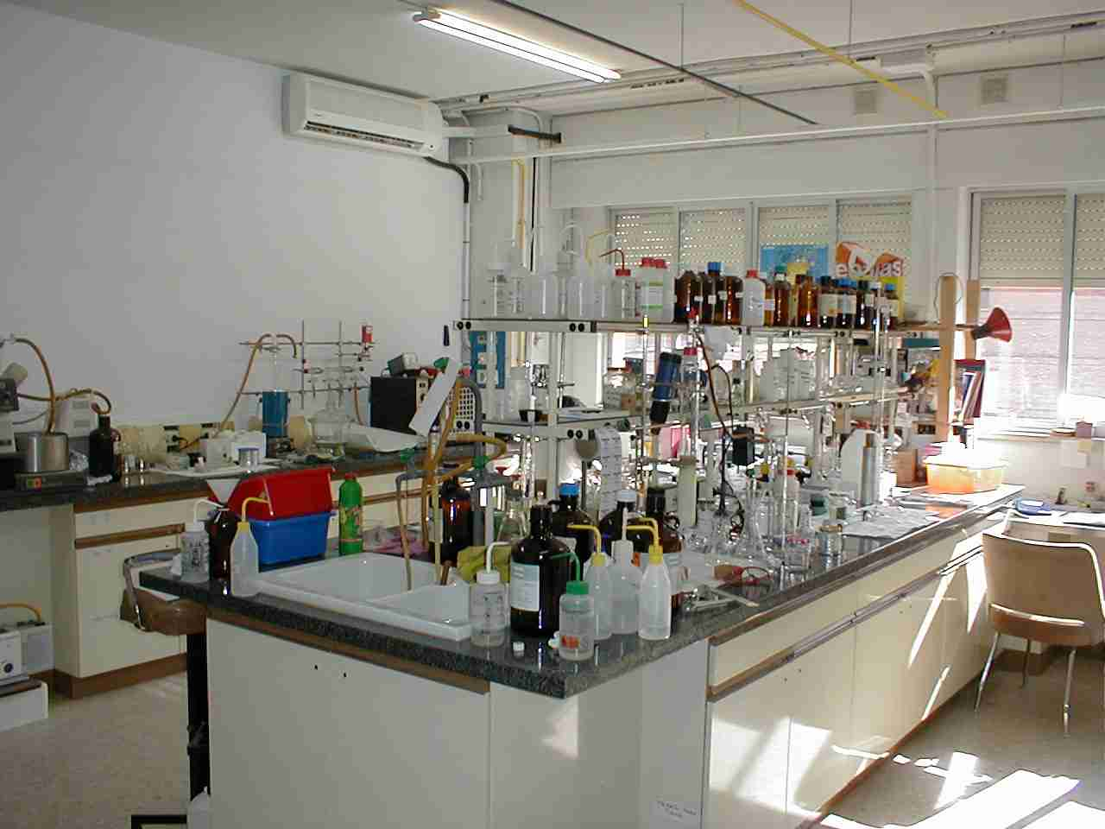
Laboratory (Lab) – place where science experiments are done

Slide 7
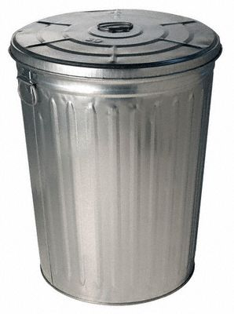
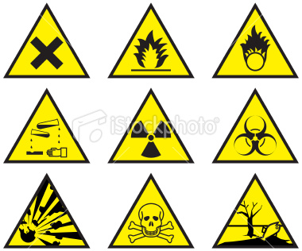
Waste Materials – chemicals or things left over after the experiment
Hazard – something dangerous

Slide 8
Laboratory Equipment

Slide 9
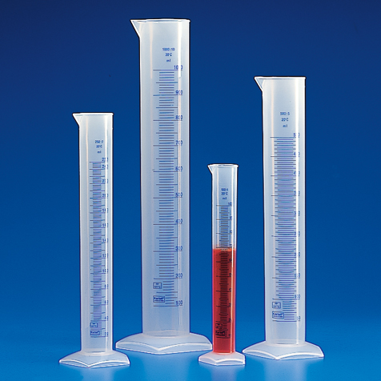
Measuring Volume
Beaker
Dropper
Graduated Cylinder

Slide 10
Measuring Distance
Meter Stick
Ruler

Slide 11
Measuring Mass
Digital Scale
Balance

Slide 12
Other Equipment
Hot Plate
Test Tube & Clamps

Slide 13
Now that we’ve learned what’s around us,
Let’s talk about proper behavior in the science classroom.

