Slide 1
The Moon

Slide 2
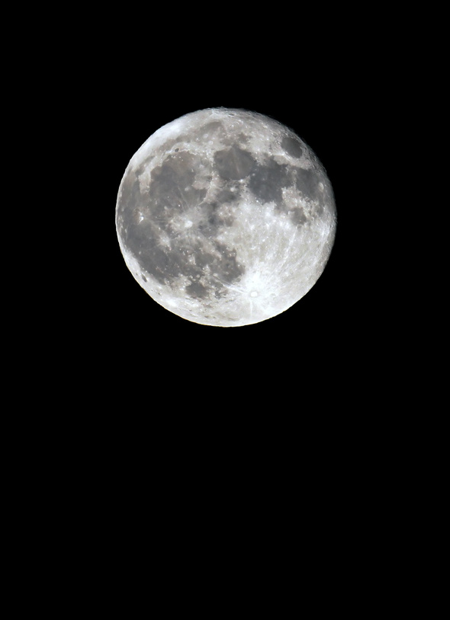
What is the Moon?
A large rock that orbits a planet
The Earth has 1 moon
Moons orbit planets
Planets orbit the sun

Slide 3
Moon Facts
The moon is 240,000 miles from Planet Earth.
The moon rotates counterclockwise.
There are holes on the moon’s surface called craters.
The moon gets its light from the reflection of the sun.

Slide 4
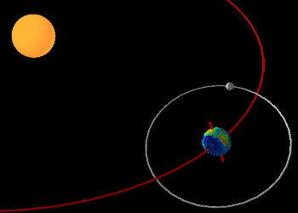
The Sun, Earth, & Moon

Slide 5
Animation of Earth, Moon, & Sun
Animated Movement of the Moon, Earth, & Sun

Slide 6
Why doesn’t the moon look the same?
As the moon orbits around the earth, the light from the sun shines on it.
From earth, we can only see certain portions of the lit moon.
It takes 1 month, approx. 29 days, for the moon to completely orbit the Earth.

Slide 7
Animation of the Moon Phases
Moon Phase Animation
Throughout a month, the moon’s position changes & we can only see some parts of the illuminated moon.

Slide 8
The Moon Causes Tides
Tides are caused by the gravitational pull of the moon.
There are two types of tides: High & Low
High tide occurs twice a day.

Slide 9
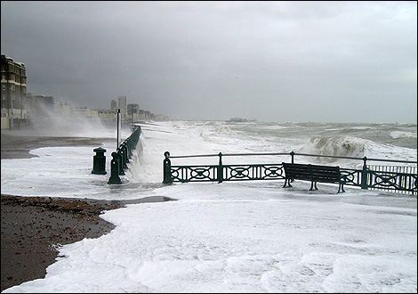
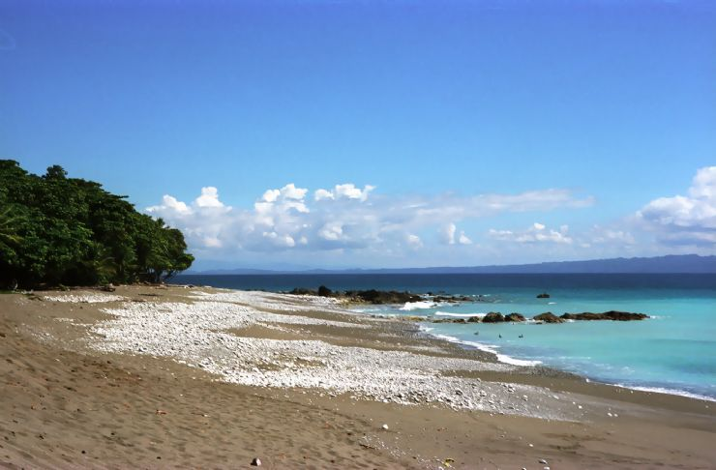
Tide Images
High Tide
Low Tide

Slide 10
Diagram of the Moon Phases
The sun is always shining on the moon.
From earth we can only see certain parts of the moon that are lit by the sun.

Slide 11
Diagram of the Moon Phases
NEW MOON
The moon is lit by the sun. However, the lit side of the moon cannot be seen from Earth. The moon appears black during the NEW MOON PHASE.

Slide 12
Diagram of the Moon Phases
The moon is lit by the sun. We can only see a small portion of the lit moon from Earth. It is called a WAXING CRESCENT.
WAXING
CRESCENT

Slide 13
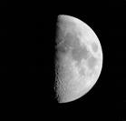
Diagram of the Moon Phases
The moon is lit by the sun. We can see half of the lit moon from Earth. It is called a WAXING HALF MOON or a FIRST QUARTER MOON.
WAXING
HALF MOON
(1ST QUARTER)

Slide 14
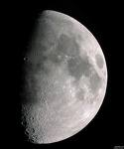
Diagram of the Moon Phases
The moon is lit by the sun. We can see a lot of the lit moon from Earth. It is called a WAXING GIBBOUS.
WAXING
GIBBOUS

Slide 15
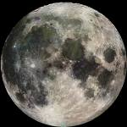
Diagram of the Moon Phases
The moon is lit by the sun. We can see the entire lit moon from Earth. This is the FULL MOON phase.
FULL MOON

Slide 16
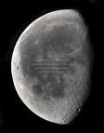
Diagram of the Moon Phases
The moon is lit by the sun. We can see a lot of the lit moon from Earth. This phase is called the WANING GIBBOUS.
WANING
GIBBOUS

Slide 17
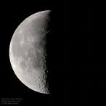
Diagram of the Moon Phases
WANING HALF MOON
(LAST QUARTER)
The moon is lit by the sun. We can see half of the lit moon from Earth. This is known as the WANING HALF MOON or LAST QUARTER.

Slide 18
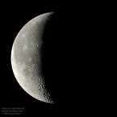
Diagram of the Moon Phases
WANING
CRESCENT
The moon is lit by the sun. We can only see a small portion of the lit moon from Earth. This is called the WANING CRESCENT.

Slide 19
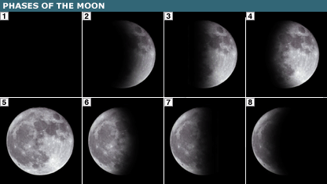
The Phases Build Upon One Another:

Slide 20
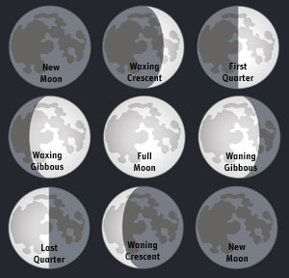
Let’s look at the phases all together:
What does WAXING mean?
What does WANING mean?
What is a CRESCENT?
What is a GIBBOUS?

