Slide 1
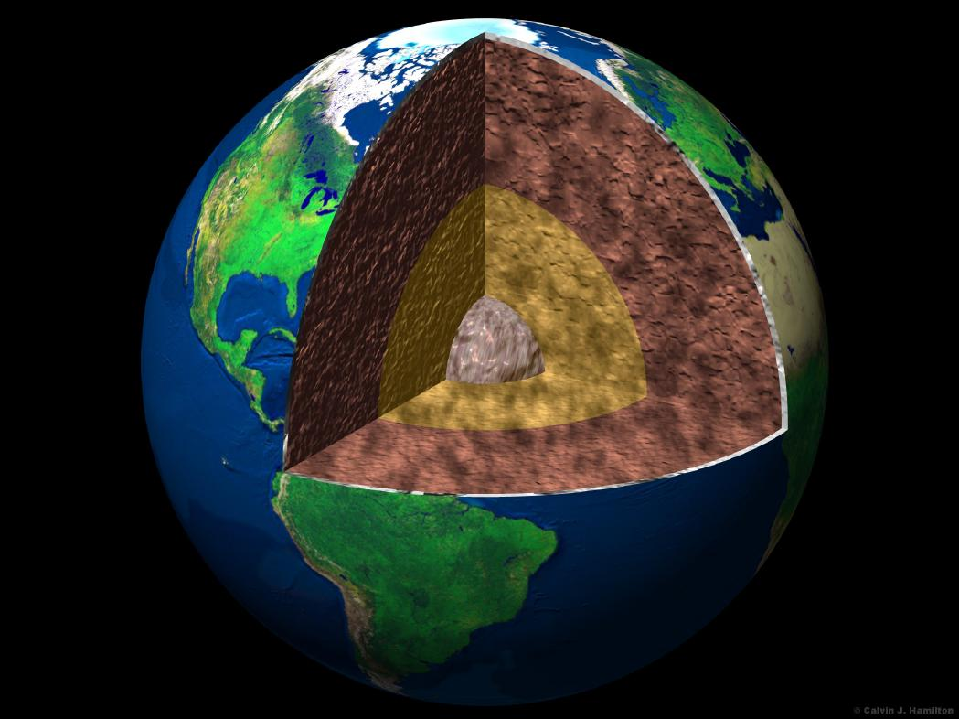
Earth's Interior Notes

Slide 2
Earth’s Layers Vocabulary
Inner core – a ball of hot solid metal (mostly iron and nickel) at the center of the earth
Outer core – liquid layer of metal (mostly iron and nickel) that surrounds the inner core
Mantle – earth’s thickest layer between the outer core and crust made of super-heated rock

Slide 3
Crust – the top layer of earth made of a thin layer of cool rock
Continental | Oceanic
Located underneath the continents Made up of many different types of rocks, but mainly granite This is what we live on! | Located beneath the oceans Made up of different materials, but mostly basalt

Slide 4
Lithosphere – the layer of earth made of the crust and the rigid rock of the upper mantle which is broken into tectonic plates
Asthenosphere – the layer in earth’s upper mantle directly under the lithosphere in which rock is soft and weak because it is close to melting

Slide 5
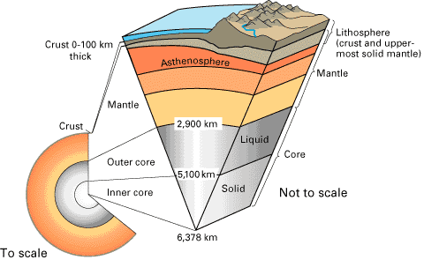
Cross-Section of the Layers of the Earth

Slide 6
Tectonic plates – the process in which the motion of a hot material under the crust changes the crust of the Earth. These are called plate tectonics and they never stop moving!
Continental drift – a theory that Earth’s continents move on the surface. We are constantly moving away from Africa/Europe and closer to Asia/Australia!
Fault line – a crack in Earth’s surface between plates

Slide 7
Pangaea – a hypothetical supercontinent in which all continents were once attached. It began breaking apart about 200 million years ago
Convection – a process by which energy is transferred to cause warmer less dense air or liquid to rise while the dense cooler liquid or air is pushed down.

Slide 8
Data Table
Depth | Name of Layer | What Layer is Made Of
20 km | crust | solid rock, mostly granite (continental) and basalt (oceanic)
150 km | asthenosphere (mantle) | soft slow flowing material
2,000 km | mantle | hot, but solid material (super-heated rock)
4,000 km | outer core | molten iron and nickel
6,000 km | inner core | solid iron and nickel

Slide 9
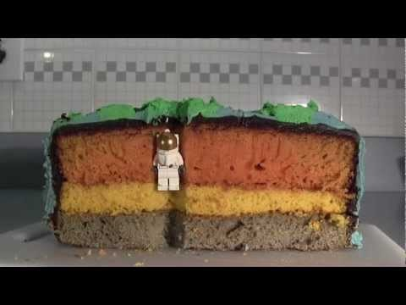
What are the layers of the Earth?

Slide 10
Earth’s Crust
Outer core
Mantle
Inner core

