Slide 1
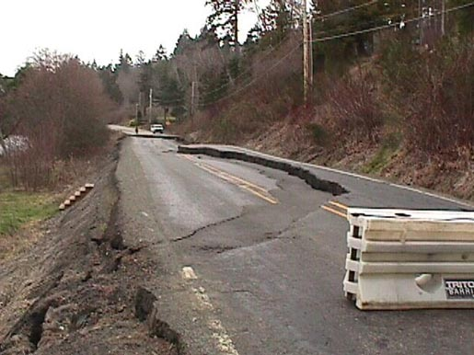
Earthquakes
Notes:
1

Slide 2
Rocks Move along Faults
An earthquake is a shaking of the ground caused by the sudden movement of large blocks of rock along a fault. Earthquakes occur along faults.
A fault is a fracture, or break, in Earth’s lithosphere, along which blocks of rock move past each other.

Slide 3
Earthquakes
A sudden release of stress in the lithosphere causes an earthquake.
Shaking and trembling of the earth’s crust.
The waves travel in all directions
More than 1,000,000 occur a year or one every 30 seconds
Earthquakes continue until all the energy is used up
TSUNAMIS- Earthquakes on the ocean floor: causing waves to become greater than 20 meters high

Slide 4
Occurrence of Earthquakes
About 80 percent of all earthquakes occur in a belt around the edges of the Pacific Ocean.
In the United States, the best-known fault
in this belt is the San Andreas Fault in California.

Slide 5
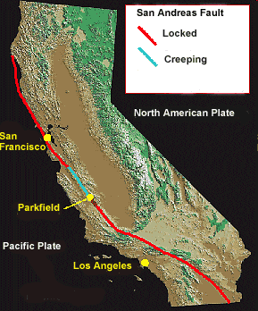
San Andreas Fault – This is a Transform Boundary that runs from the Gulf of California through the San Francisco area.

Slide 6
Kinds of Faults
The three main types of faults are
1) Normal faults,
2) Reverse faults, and
3) Strike-slip faults.

Slide 7
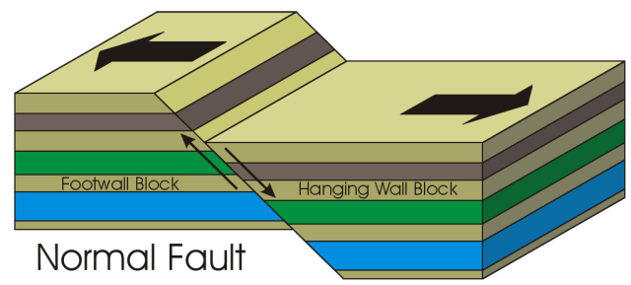
Normal Faults
Here the block of rock above the fault plane slides down relative to the other block. Stress that pulls rocks apart causes normal faults. Example - Great Rift Valley of Africa.

Slide 8
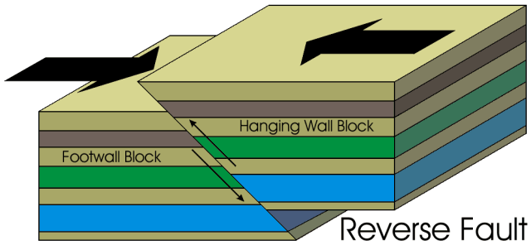
Reverse Faults
Here the block of rock above the fault plane moves up relative to the other block. Stress that presses rocks together causes reverse faults. These faults can occur near collision-zone boundaries between plates. Example - Himalayan Mountains have many earthquakes along reverse faults.

Slide 9
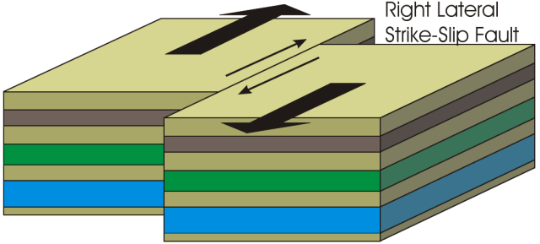
Strike-Slip Faults
Here blocks of rock move sideways on either side of the fault plane. Stress that pushes blocks of rock horizontally causes earthquakes along strike-slip faults. These faults can occur where plates scrape past each other. The San Andreas Fault is a strike-slip fault.

Slide 10
Seismic Waves
Energy from earthquakes travels through Earth. The energy travels as seismic waves which are vibrations caused by earthquakes. Seismic waves from even small earthquakes can be recorded by sensitive instruments around the world.

Slide 11
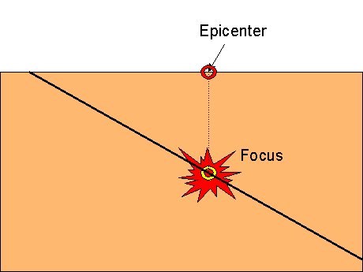
Focus and Epicenter
All earthquakes start beneath Earth’s surface. The focus of an earthquake is the point underground where rocks first begin to move. Seismic waves travel outward from the earthquake’s focus. The epicenter is the point on Earth’s surface directly above the focus.

Slide 12
Seismic Waves
Earthquakes produce three types of seismic waves: primary waves, secondary waves, and surface waves. Each type moves through materials differently. In addition, the waves can reflect, or bounce, off boundaries between different layers. The waves can also bend as they pass from one layer into another. Scientists learn about Earth’s layers by studying the paths and speeds of seismic waves traveling through Earth.

Slide 13
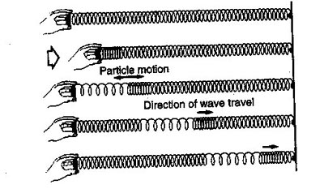
Primary or P Waves
Primary waves are the fastest(5 km or 3mi/sec) and arrive first at the epicenter
Can travel through solids, liquids, and gases
They are push-pull waves

Slide 14
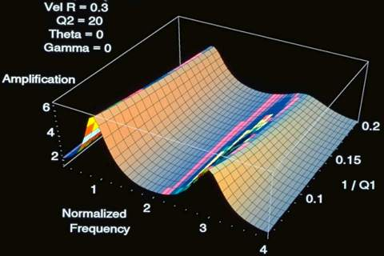
Secondary or S Waves
the second seismic waves to arrive at any particular location after an earthquake,
travel through Earth’s interior at about half the speed of primary waves.
Can travel through solids, but NOT through liquids and gases
Move in up-down motion

Slide 15
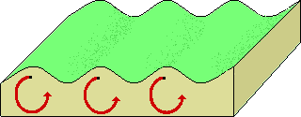
Surface or L Waves
seismic waves that move along Earth’s surface, not
through its interior.
make the ground roll up and down or shake from side to side.
Slowest moving seismic waves
Travel on top of Earth’s surface
cause the largest ground movements and the most damage as they bend and twist the surface

Slide 16
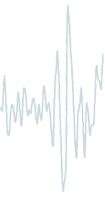
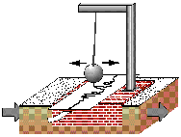
Seismograph-an instrument that constantly records ground movements
Seismogram- Paper record of waves also used to determine an earthquakes magnitude or strength.
Seismologists- scientists who study earthquakes
Richter Scale- a scale that allows scientists to determine earthquake strength based on many readings. 1-10 are levels at which an earthquake is measured based on amount of damage caused; Levels above 7 are destructive. Each increasing number has 32 times more energy.

Slide 17
Damage from Earthquakes
Loss of life
Damage to buildings
Can cause fires (broken natural-gas lines, electrical power lines, or overturned stoves.)

Slide 18
Aftershocks
An aftershock is a smaller earthquake
that follows a more powerful earthquake in the same area. Sometimes structures weakened by an earthquake collapse during shaking caused by aftershocks.

Slide 19
Liquefaction
Earthquakes can cause soil liquefaction, a process in which shaking of the ground causes soil to act like a liquid. For a short time the soil becomes like a thick soup. Liquefaction occurs only in areas where the soil is made up of loose
sand and silt and contains a large amount of water. As the shaking temporarily changes the wet soil, structures either sink down into the soil or flow away with it.

Slide 20
Tsunamis
A special type of wave, can make water rise more than the height of a 20-story building. This wave, known as a tsunami, is a water wave triggered by an earthquake, volcanic eruption, or landslide. Tsunamis are sometimes called tidal waves.

Slide 21
The End

Slide 22
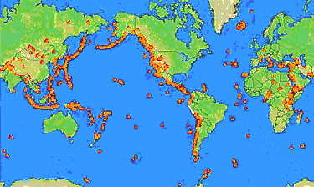
Ring of Fire

