Slide 1
Characteristics of Soil
Quarter One: Lithosphere Unit

Slide 2
What is a soil horizon?
-Horizon is a side profile of the layers of soil
-Soil is usually divided into 3 main layers, but will also include the layers above and below for a total of 5 layers.

Slide 3
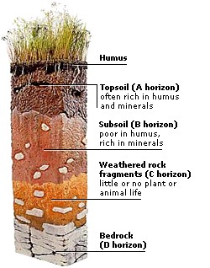
What are the soil horizons??

Slide 4
What is the O Horizon (litter)?
-Not really a layer of soil
-It’s on top of the first layer of soil
-Contains grass, plants, and animals

Slide 5
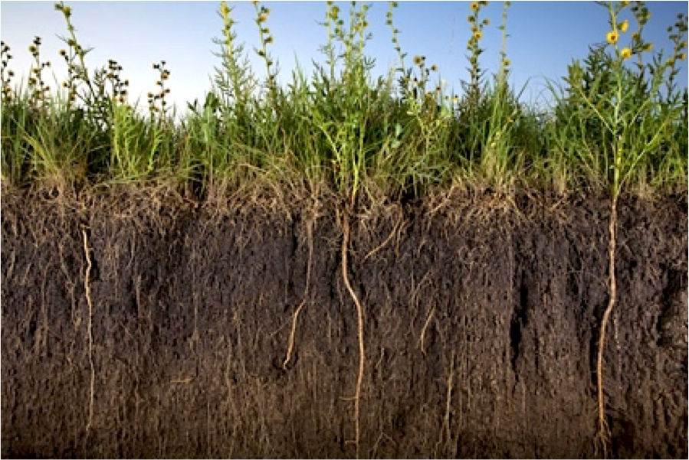
What is the A Horizon (topsoil)?
-First layer of soil
-Darkest layer of soil
-Contains humus, plant roots, small animals, water, and nutrients for plant growth
-The darker the soil, the more nutrients it contains

Slide 6
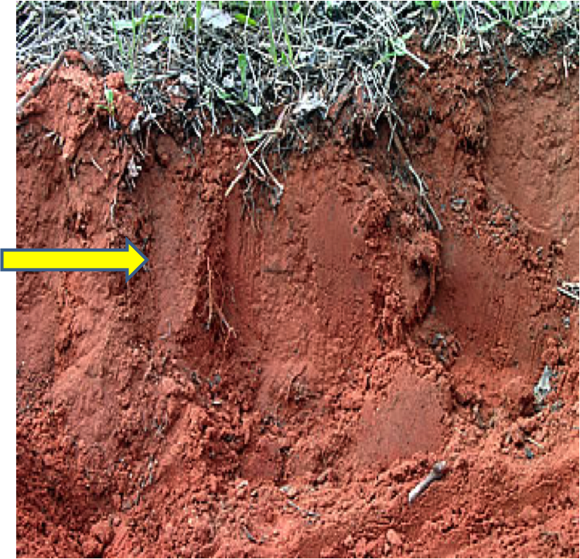
What is the B Horizon (subsoil)?
-Second layer of soil
-Lighter in color (reddish brown)
-Fewer nutrients and water
-Limited plant growth

Slide 7
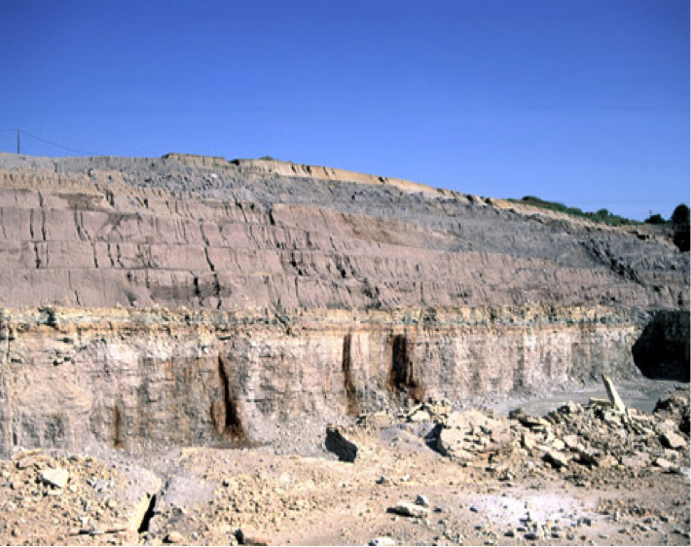
What is the C Horizon (parent material)?
-Third layer of soil
-Lightest in color (gray)
-No nutrients, animals, or plant growth
-Contains weathered rock and sediment

Slide 8
What is the R Horizon (bedrock)?
-Below the last layer of soil
-Solid Rock
-Has not been weathered or broken down yet
-No soil in this layer

Slide 9
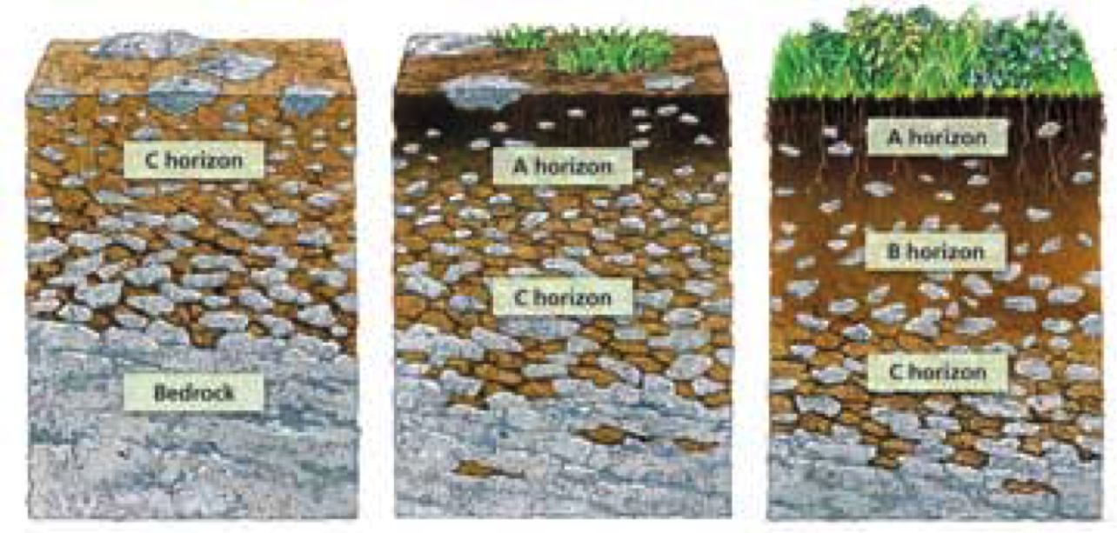
How is soil formed?
-From the weathering (breaking down) of rocks.
-Warm and wet climates, soil forms fastest
-Cold and dry climates, soil forms the slowest

Slide 10
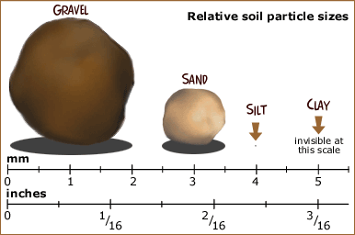
What are the characteristics of soil?
-Texture-what the soil feels like
-Particle Size (see picture)
-pH-acidity in the soil
-Water retention-how well it holds water
-Viability-nutrients in the soil (nitrogen, phosphorus, etc).

